Slide 1
Familiarize yourself with phishing attacks
<HR and Marketing>

Slide 2
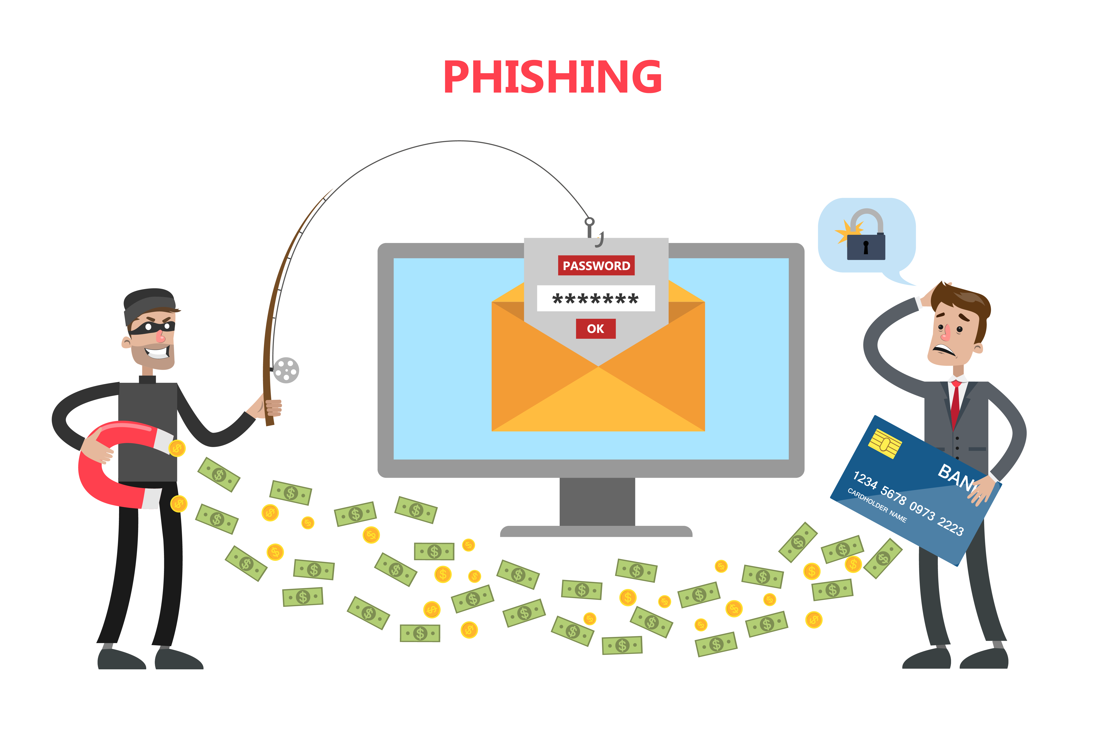
What is phishing?
Phishing is a type of cyberattack that uses fraudulent emails, text messages, phone calls or websites to trick people into sharing sensitive data, downloading malware or otherwise exposing themselves to cybercrime. In a typical phishing scam, a hacker pretends to be someone the victim trusts, like a colleague, boss, authority figure or representative of a well-known brand. The hacker sends a message directing the victim to pay an invoice, open an attachment, click a link or take some other action.

Slide 3
Learn to spot phishing emails
Phishing scams try to make victims feel a sense of urgency so that they act quickly without thinking. Scammers often do this by invoking strong emotions like fear, greed and curiosity. They might impose time limits and threaten unrealistic consequences, such as jail time.
Common phishing ruses include:
"There is a problem with your account or financial information. You must update it immediately to avoid losing access.“
"We have detected illegal activity. Pay this fine now, or else you will be arrested." "You have won a free gift, but you must claim it right now."

Slide 4
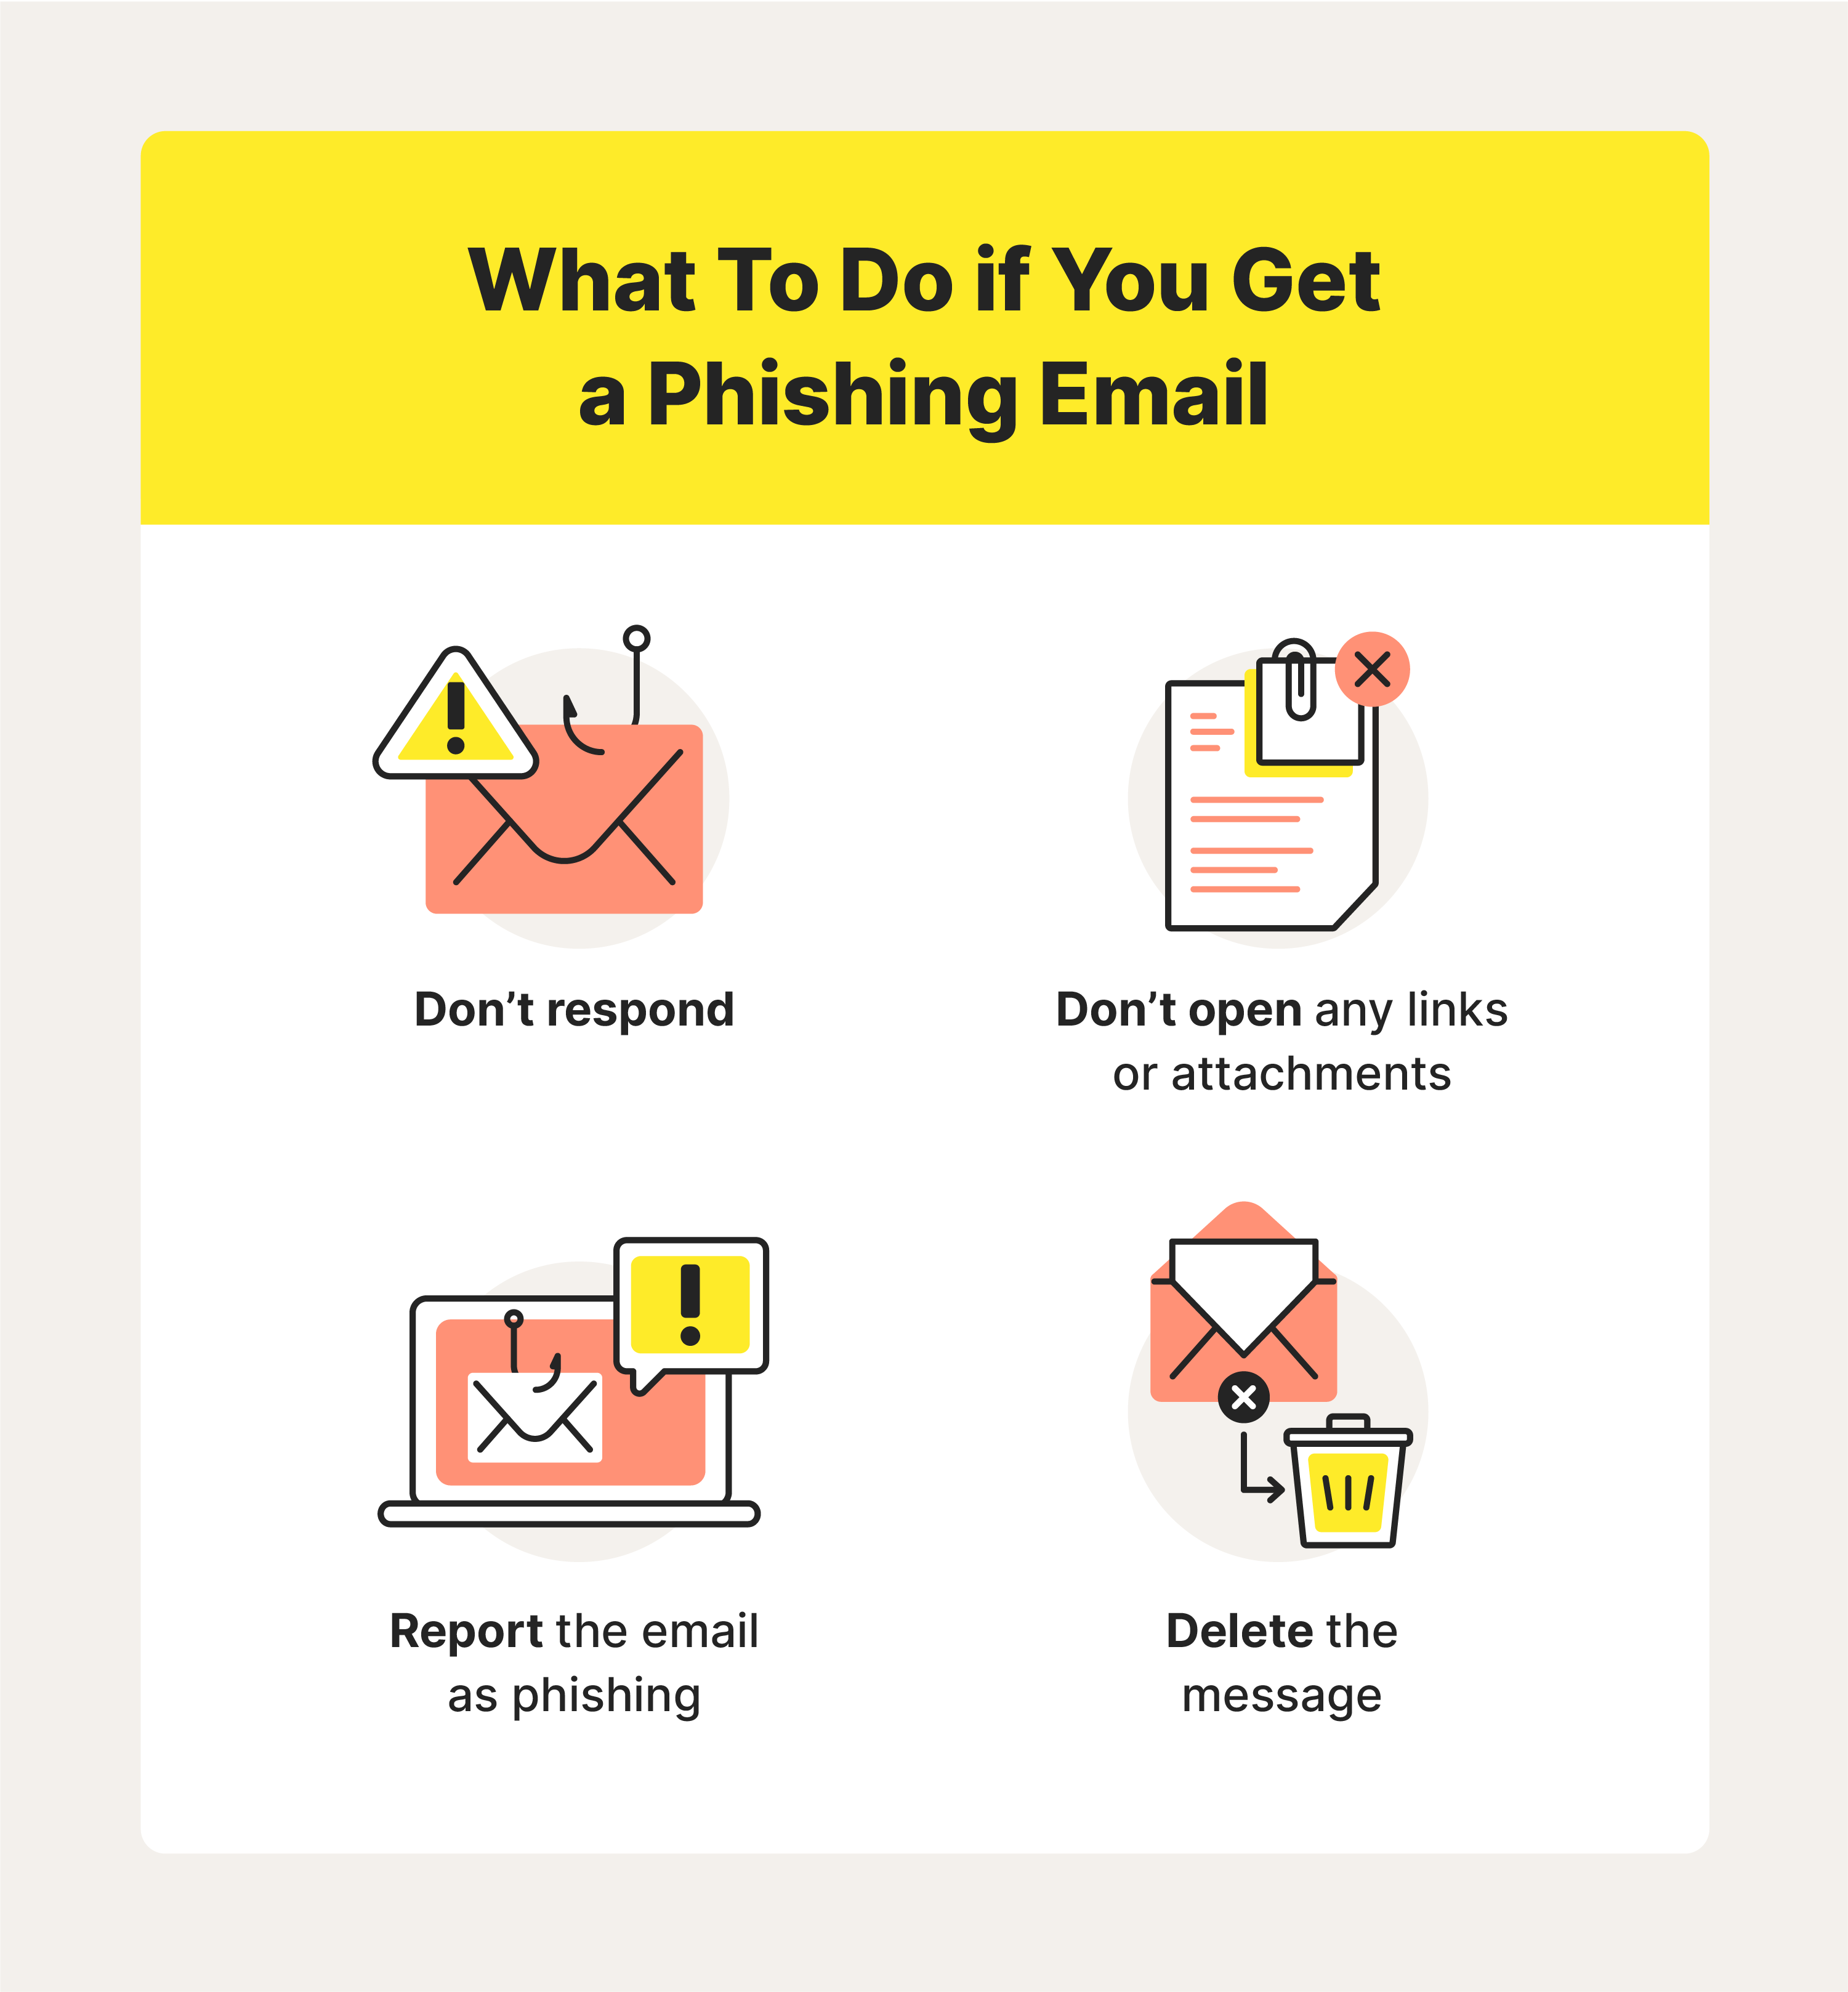
How do we stop getting phished?
Organizations can also establish policies and practices that make it harder for phishers to succeed.
For example, organizations can forbid people from initiating monetary transfers over email. They can require employees to verify requests for money or information by contacting the requester through means other than those provided in the message. For example, employees can type a URL directly into their browser instead of clicking a link or call a colleague's office line instead of replying to a text from an unknown number.

